Slide 1


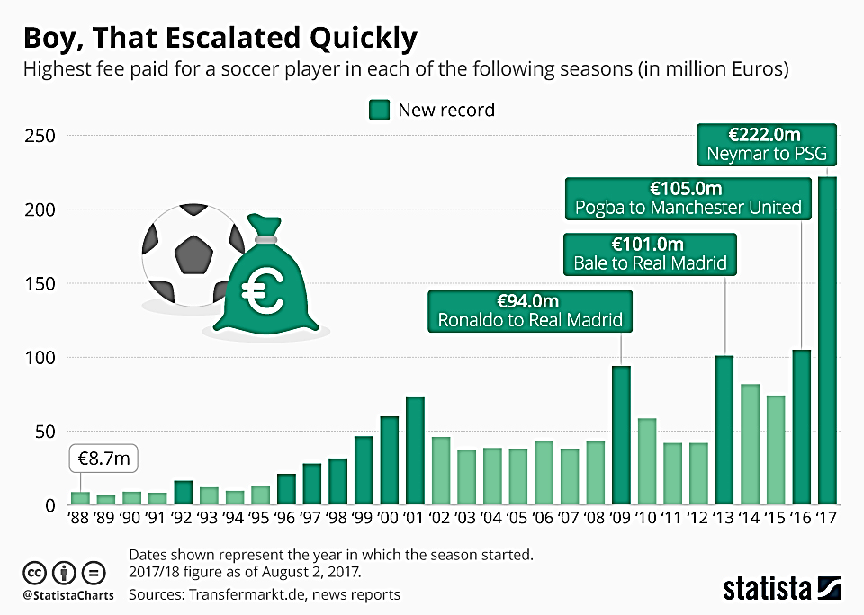
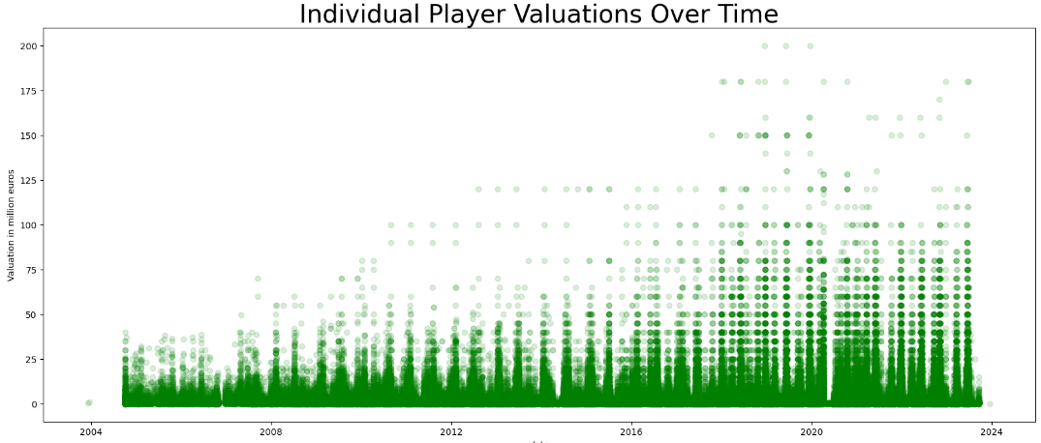
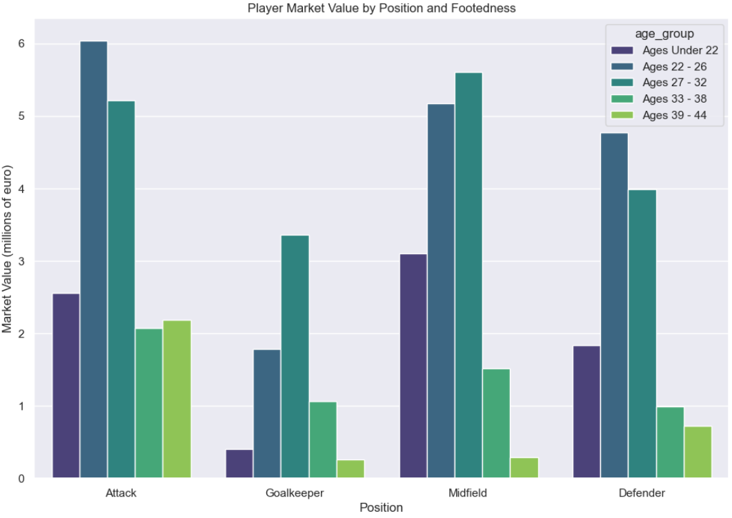
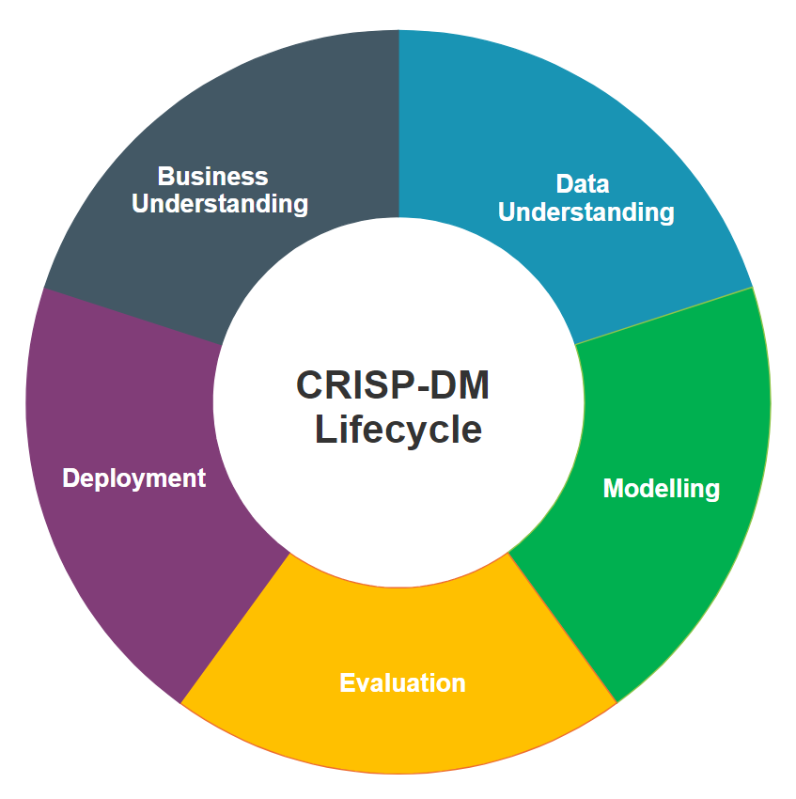

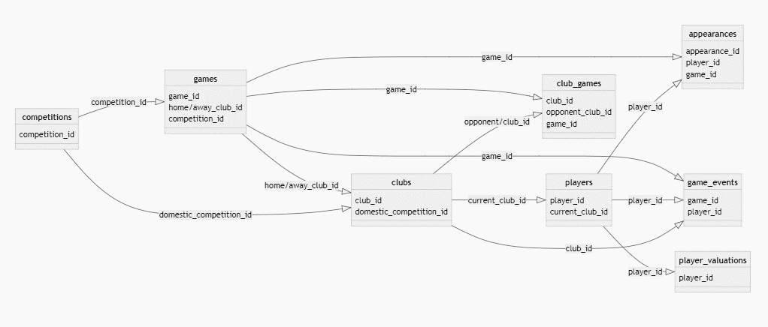
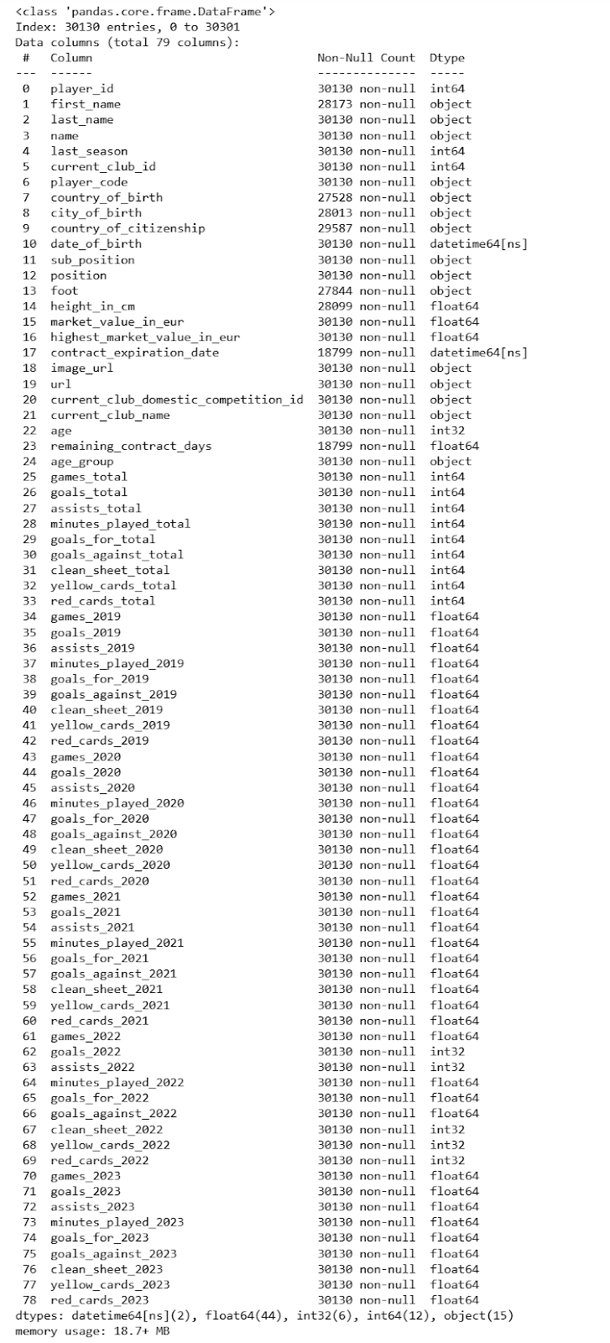
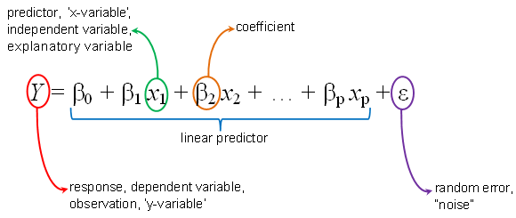
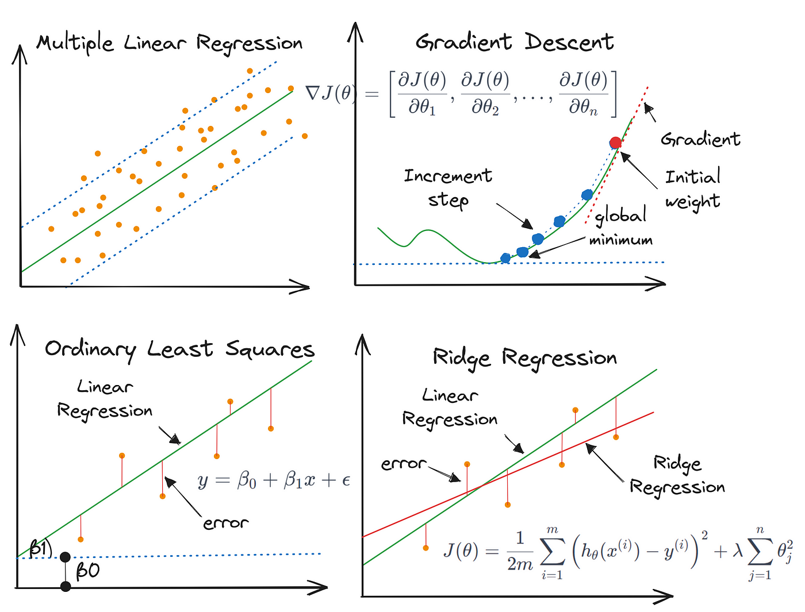
Leveraging Machine Learning and Data Science for Competitive Advantage: Estimating Football Player Market Values
Author: Kavi Patak Lecturer: James Garza
Introduction
2. Exploratory Data Analytics
The role of analytics in football has evolved over the past decade, and will continue to do so. Technological developments continue to improve the volume and quality of data available to the world’s leading clubs, as well as the ability to derive insight from them. The opportunity exists for clubs of all sizes to use analytics to build a sustainable competitive advantage, something which will be most evident in the area where they invest most: the transfer market.
The Process…
Business Understanding
3. Preprocessing
The role of analytics in football has evolved over the past decade, and will continue to do so. Technological developments continue to improve the volume and quality of data available to the world’s leading clubs, as well as the ability to derive insight from them. The opportunity exists for clubs of all sizes to use analytics to build a sustainable competitive advantage, something which will be most evident in the area where they invest most: the transfer market.
The role of analytics in football has evolved over the past decade, and will continue to do so. Technological developments continue to improve the volume and quality of data available to the world’s leading clubs, as well as the ability to derive insight from them. The opportunity exists for clubs of all sizes to use analytics to build a sustainable competitive advantage, something which will be most evident in the area where they invest most: the transfer market.
Evaluation
Data Understanding
1. Merging and Characterising the Data
Modelling
Data: “Football Data from Transfermarkt” provided by Kaggle
Available at: https://www.kaggle.com/datasets/davidcariboo/player-scores/versions/284
9 CSV Files
appearances_df : (1485697, 13)
club_games_df : (128586, 11)
clubs_df: (426, 16)
competitions_df: (43, 10)
game_events_df: (652010, 10)
game_lineups_df : (86822, 9)
games_df : (64293, 23)
player_valuations_df : (440663, 9)
players_df: (30302, 23)
Deployment
The Combined
Conclusion
References

Slide 2
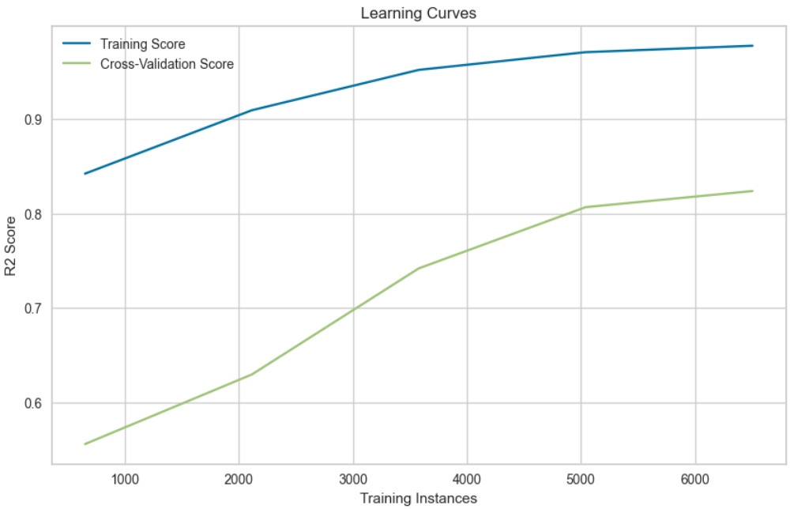
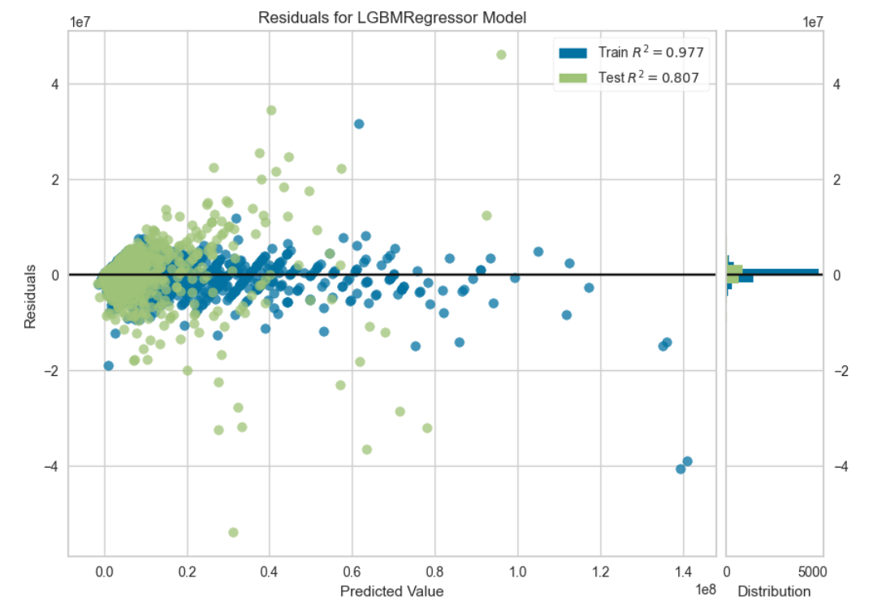
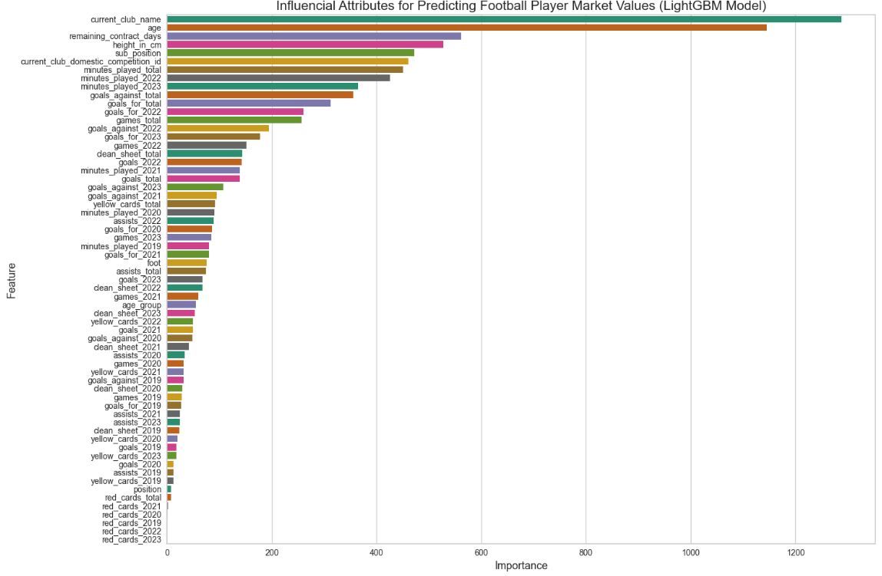

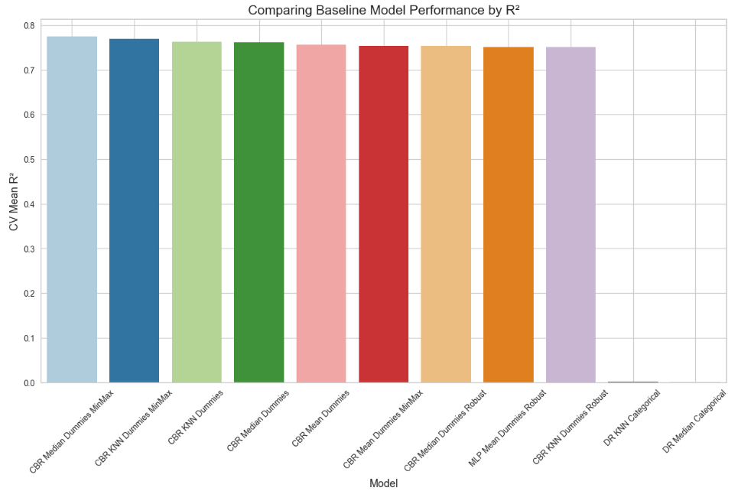
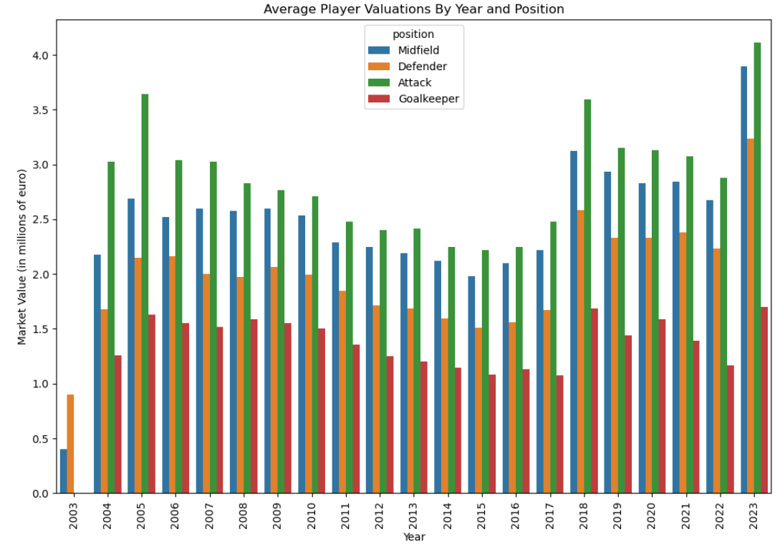
Leveraging Machine Learning and Data Science for Competitive Advantage: Estimating Football Player Market Values
Author: Kavi Patak Lecturer: James Garza
Introduction
The role of analytics in football has evolved over the past decade, and will continue to do so. Technological developments continue to improve the volume and quality of data available to the world’s leading clubs, as well as the ability to derive insight from them. The opportunity exists for clubs of all sizes to use analytics to build a sustainable competitive advantage, something which will be most evident in the area where they invest most: the transfer market.
The Methodology…
Business Understanding
3. Preprocessing
This initial phase focuses on understanding the project objectives and requirements from a business perspective. It involves understanding what the stakeholders want to achieve, defining the project goals, and translating these goals into Data Analytics and Machine Learning objectives.
Data preprocessing is a crucial step in any Data Science project’s lifecycle. It involves several operations and transformations being applied to raw data to make it suitable for analysis and modelling. The aim is to enhance the quality of the data by addressing missing or inconsistent values, handling various data types including type casting, number formatting, and label encoding categorical variables, transforming the data using scaling, standardisation or normalisation techniques, and conducting feature engineering.
Evaluation
This initial phase focuses on understanding the project
objectives and requirements from a business perspective. It involves understanding what the stakeholders want to achieve, defining the project goals, and translating these goals into Data Analytics and Machine Learning objectives.
1. Consolidating and Characterising the Data
Data Understanding
In this phase, we gather and understand the data required for the project. This includes identifying data sources, collecting data, and exploring its structure, quality, and content. It's important to assess whether the available data is sufficient to address the project
objectives.
Merged Dataset
Modelling
Data: “Football Data from Transfermarkt” provided by Kaggle
Available at: https://www.kaggle.com/datasets/davidcariboo/player-scores/versions/284
9 CSV Files:
appearances_df : (1485697, 13)
club_games_df : (128586, 11)
clubs_df: (426, 16)
competitions_df: (43, 10)
game_events_df: (652010, 10)
game_lineups_df : (86822, 9)
games_df : (64293, 23)
player_valuations_df : (440663, 9)
players_df: (30302, 23)
2. Exploratory Data Analytics
Deployment
EDA is a process of examining the available data to discover patterns of correlation, identify trends, and gain insights of interest. It aids in spotting anomalies, testing hypotheses and clarifying any assumptions.
We find that the target variable, ‘Market Value’ does not follow a normal distribution, and contains multiple outliers identifiable through the histogram and boxplot below.
Conclusion
Through EDA we discover similar patterns and irregularities within the independent variables used for predicting. These finding will influence preprocessing decision and techniques for Machine Learning .
References

Slide 3
Leveraging Machine Learning and Data Science for Competitive Advantage: Estimating Player Market Values
By Kavi Patak
Introduction
The role of analytics in football has evolved over the past decade, and will continue to do so. Technological developments continue to improve the volume and quality of data available to the world’s leading clubs, as well as the ability to derive insight from them. The opportunity exists for clubs of all sizes to use analytics to build a sustainable competitive advantage, something which will be most evident in the area where they invest most: the transfer market.
The Process…
Business Understanding
The role of analytics in football has evolved over the past decade, and will continue to do so. Technological developments continue to improve the volume and quality of data available to the world’s leading clubs, as well as the ability to derive insight from them. The opportunity exists for clubs of all sizes to use analytics to build a sustainable competitive advantage, something which will be most evident in the area where they invest most: the transfer market.
Evaluation
Data Understanding
Modelling
The role of analytics in football has evolved over the past decade, and will continue to do so. Technological developments continue to improve the volume and quality of data available to the world’s leading clubs, as well as the ability to derive insight from them. The opportunity exists for clubs of all sizes to use analytics to build a sustainable competitive advantage, something which will be most evident in the area where they invest most: the transfer market.
The role of analytics in football has evolved over the past decade, and will continue to do so. Technological developments continue to improve the volume and quality of data available to the world’s leading clubs, as well as the ability to derive insight from them. The opportunity exists for clubs of all sizes to use analytics to build a sustainable competitive advantage, something which will be most evident in the area where they invest most: the transfer market.
Deployment

Slide 4
